Slide 1

Land Use and Development Regulations
Our object in the construction of the state is the greatest happiness of the whole, and not that of any one class. - Plato
The building of cities is one of man's greatest achievements. - Edmund Bacon
Civil Engineering and Architecture
© 2010 Project Lead The Way, Inc.
Notes:
Land Use and Regulations
Civil Engineering and Architecture
Unit 3 – Lesson 3.1 – Commercial Building Systems
Project Lead The Way, Inc
Copyright 2010

Slide 2
Land Use Planning
(Urban Planning)
Planning for the long-term growth of an area
Purpose:
  Preserve public health, safety, and welfare
  Maintain compatible development within an area
  Provide adequate air, light, access, and open space
  Protect the natural environment and historic resources
  Minimize traffic congestion
  Enhance the streetscape and pedestrian environment
Regulated by municipalities
(towns, cities, counties)
Notes:
Civil Engineering and Architecture
Unit 3 – Lesson 3.1 – Commercial Building Systems
Project Lead The Way, Inc
Copyright 2010
Land Use and Regulations

Slide 3
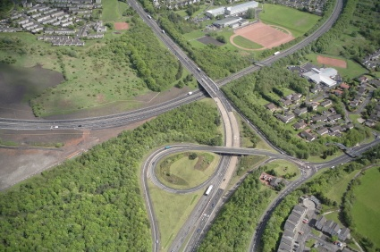
Land Use Regulations
Often called Ordinances
May regulate a variety of aspects of development
  Allowed uses on property
  Building and lot size
  Access to property
  Parking lot designs
  Setbacks
  Landscaping
  Many others
©iStockphoto.com
Notes:
Civil Engineering and Architecture
Unit 3 – Lesson 3.1 – Commercial Building Systems
Project Lead The Way, Inc
Copyright 2010
Land Use and Regulations

Slide 4
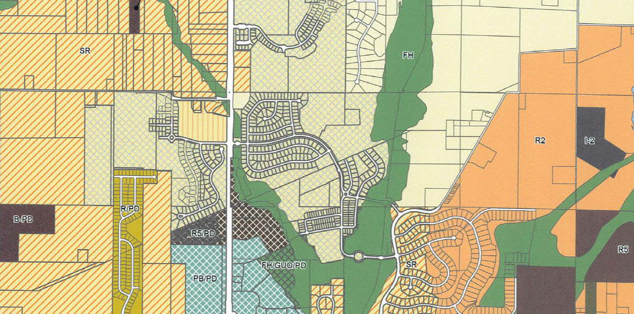
Zoning
Most common form of land use regulation
Zoning maps designate permitted uses of land tied to mapped areas
Notes:
Civil Engineering and Architecture
Unit 3 – Lesson 3.1 – Commercial Building Systems
Project Lead The Way, Inc
Copyright 2010
Land Use and Regulations

Slide 5
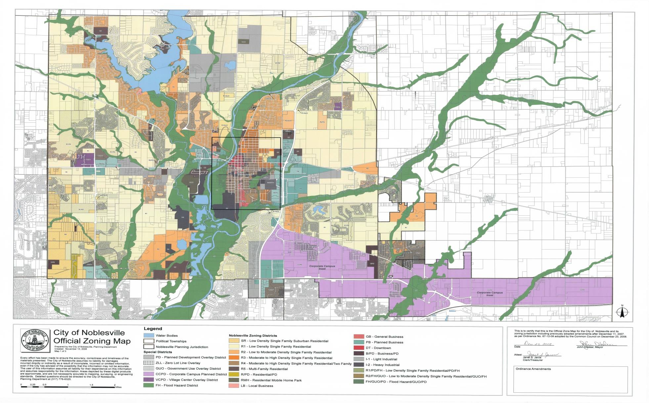
Noblesville, IN Zoning Map
Many zoning maps are available online or from your local building department.
Notes:
The Keystone Library project is located within the city of Noblesville, IN
Point out the many different zoning designations (colors on the map). The next slide contains a larger key.
Civil Engineering and Architecture
Unit 3 – Lesson 3.1 – Commercial Building Systems
Project Lead The Way, Inc
Copyright 2010
Land Use and Regulations

Slide 6

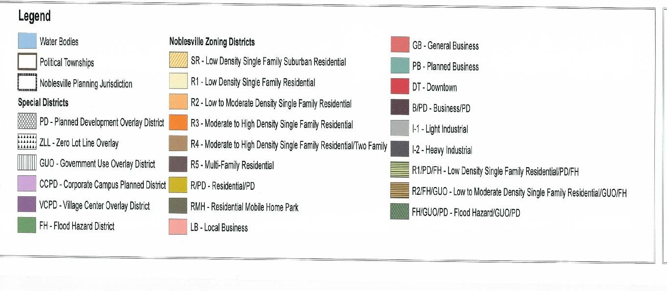
Zoning Designations
Typically include one or more variations of the following types of use
Notes:
Local ordinances give specific rules and requirements for each different designation.
Noblesville has designated seven different commercial districts, including
1. Local Business (LB)
2. General Business (GB)
3. Downtown (DT)
4. Planned Business (PB)
5. Village Center Commercial (VCC)
6. Village Center Mixed Use (VCM)
7. Business Planned Development (B/PD)
The regulations are different for each zone. Engineers and architects must be familiar with the ordinances in order to comply with the various zoning requirements.
Civil Engineering and Architecture
Unit 3 – Lesson 3.1 – Commercial Building Systems
Project Lead The Way, Inc
Copyright 2010
Land Use and Regulations

Slide 7

Land Use Ordinances
Based on mapped zones
Development in each zone designation is controlled by regulations specific to that zone
©iStockphoto.com
Notes:
For example a local zoning ordinance may identify a high density Single Family Residential Zone.
Some of the requirements in the zone may include
Minimum lot area is 6000 sq ft
Minimum lot width is 60 ft
Maximum building height is 35 ft
Buildings cannot be constructed within 5 feet of the property line
Minimum square footage of home is 800 sq ft
Impervious surface areas can not exceed 30% of the lot area
All homes must tie into the municipal sanitary sewer system
Many, many more requirements
Civil Engineering and Architecture
Unit 3 – Lesson 3.1 – Commercial Building Systems
Project Lead The Way, Inc
Copyright 2010
Land Use and Regulations

Slide 8
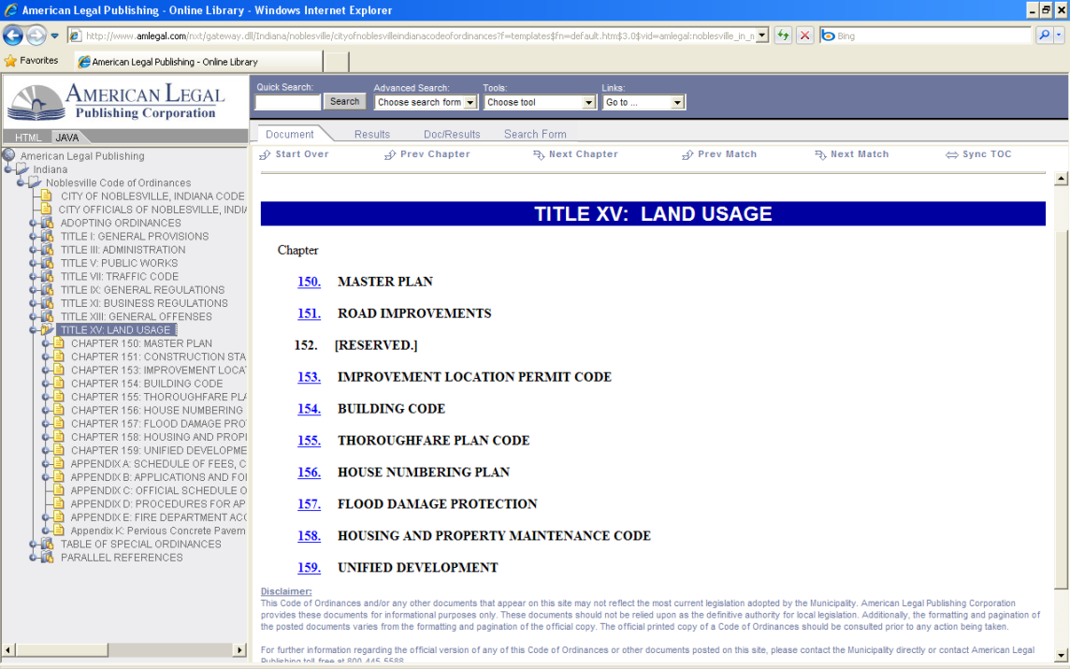
Code or Ordinances
Many municipal ordinances are published online.
Resources:
Local municipal website
www.municode.com
www.amlegal.com
Notes:
The Noblesville Ordinances are available at www.amlegal.com.
Civil Engineering and Architecture
Unit 3 – Lesson 3.1 – Commercial Building Systems
Project Lead The Way, Inc
Copyright 2010
Land Use and Regulations

Slide 9
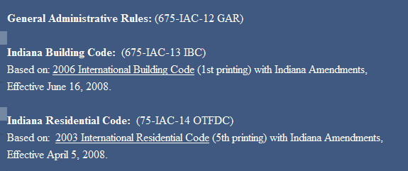
Code or Ordinances
Many municipal ordinances adopt national model codes
http://www.iabo.com/currentcodes.htm
Notes:
Many municipal codes adopt national model codes by reference. For example, the Indiana Building code is based on 2006 International Building Code and the Indiana Residential Code is based on the 2003 International Residential Code.
Civil Engineering and Architecture
Unit 3 – Lesson 3.1 – Commercial Building Systems
Project Lead The Way, Inc
Copyright 2010
Land Use and Regulations

Slide 10
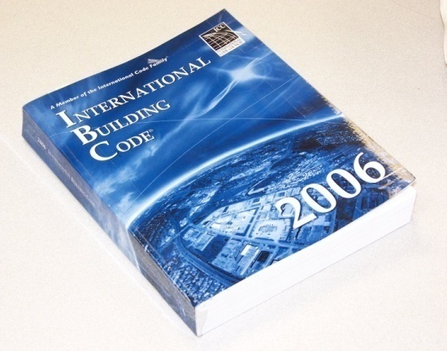
International Building Code (IBC)
Local municipalities usually adopt the IBC but may publish their own modifications
Modifications and specifications are generally published on the Internet for all to reference
Engineering firms have at least one copy to use for continual reference
Notes:
The International Building Code addresses many aspects of building construction and provides minimum requirements to safeguard the public health and safety and general welfare of occupants.
The IBC applies to all buildings that are not within the scope of the International Residential Code.
Civil Engineering and Architecture
Unit 3 – Lesson 3.1 – Commercial Building Systems
Project Lead The Way, Inc
Copyright 2010
Land Use and Regulations

Slide 11
IBC Classification
To properly use the IBC, a building design must be classified in two important ways.
  Occupancy – The building is classified in the group that its occupancy most resembles
  Construction Type – The five construction types categorize buildings constructed of materials with varying degrees of combustibility
The primary purpose of these classifications is fire safety.
Notes:
Civil Engineering and Architecture
Unit 3 – Lesson 3.1 – Commercial Building Systems
Project Lead The Way, Inc
Copyright 2010
Land Use and Regulations

Slide 12
Occupancy Groups
A – Assembly, theaters, churches
B – Business, office buildings, service-type uses
E – Educational buildings
F – Factories
H – Hazardous, buildings where flammable liquids are stored
I – Institutional, hospitals, jails
M – Mercantile, departments stores, markets
R – Residential, single or multi-family
S – Storage
U – Utility and miscellaneous
Notes:
Civil Engineering and Architecture
Unit 3 – Lesson 3.1 – Commercial Building Systems
Project Lead The Way, Inc
Copyright 2010
Land Use and Regulations

Slide 13
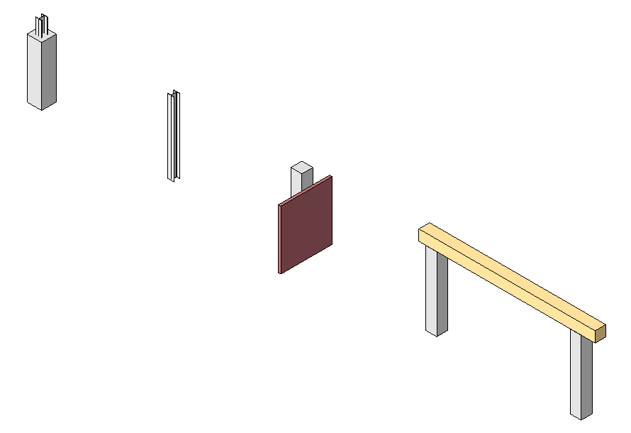
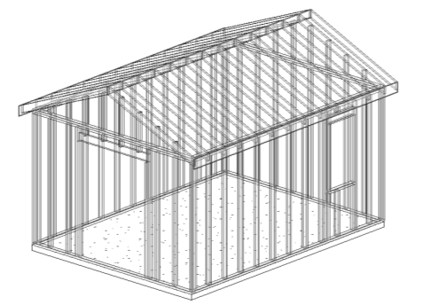
Construction Types
I
II
III
IV
V
Steel framing encased in concrete or fire-proofing
Steel framing
Noncombustible exterior, treated wood interior
Heavy timber
Any materials allowed by code may be used
Notes:
Civil Engineering and Architecture
Unit 3 – Lesson 3.1 – Commercial Building Systems
Project Lead The Way, Inc
Copyright 2010
Land Use and Regulations

Slide 14
Construction Types
Construction types determine the materials that can and cannot be used.
I
II
III
IV
V
Walls, floors, roofs, and exits must be constructed of noncombustible materials such as concrete, steel, and masonry.
Exterior walls are made of noncombustible materials. Interior elements can be made of fire-retardant-treated wood.
Increasing Fire Resistance and
Evacuation Time for Occupants
Increasing Cost of Construction
Exterior walls are made of noncombustible materials. Interior elements are of solid or laminated wood.
Walls, floors, roofs, and exits can be constructed of any material allowed by the code.
Notes:
Civil Engineering and Architecture
Unit 3 – Lesson 3.1 – Commercial Building Systems
Project Lead The Way, Inc
Copyright 2010
Land Use and Regulations

Slide 15
Construction Types
Fire Resistance
I
II
III
IV
V
A B
The fire resistance of I-A is greater than that of I-B
A B
Increasing Fire Resistance and
Evacuation Time for Occupants
A B
Increasing Cost of Construction
HT
A B
Notes:
Building components are rated for their fire resistance a particular building component. For instance, and 8 inch thick concrete wall might have a 4 hour fire rating, whereas a wood stud wall with insulation and gypsum board finish on both sides might have a fire rating of only 1 hour. The letters A and B refer to the level of fire resistance rating. A an indicates a higher fire resistance rating than a B.
Civil Engineering and Architecture
Unit 3 – Lesson 3.1 – Commercial Building Systems
Project Lead The Way, Inc
Copyright 2010
Land Use and Regulations

Slide 16
Table 503 in the IBC
Construction Type
Type I Type II Type III Type IV Type V
A
B
E
F
H
I
M
R
S
U
The intended building occupancy and height of the building will determine the Construction Type allowed by the code
When designing a building, begin with occupancy classification
Notes:
Civil Engineering and Architecture
Unit 3 – Lesson 3.1 – Commercial Building Systems
Project Lead The Way, Inc
Copyright 2010
Land Use and Regulations

Slide 17
Image Resources
City of Noblesville, IN. Retrieved August 19, 2009, from
http://www.cityofnoblesville.org/planning/
iStockphotos.com
Notes:
Civil Engineering and Architecture
Unit 3 – Lesson 3.1 – Commercial Building Systems
Project Lead The Way, Inc
Copyright 2010
Land Use and Regulations

